Slide 1
ASB Mobile
Notes:
Working on ASB Mobile:
- iOS
- Server Side

Slide 2





64 % | < 2 % | 34 %
ASB Mobile
ASB Business
100,000’s | 1000’s
Notes:
Mobile Team
- Two teams - Team A (Awesome) Team B (Brilliant)
- 3 platforms
To product:
- ASB mobile (Mojo)
- ASB Business (BOSS)

Slide 3






Continuous Integration
Notes:
VS + TFS
- Server side Builds
- Windows Phone Builds
- Git repo (hosted on TFS) for Android + iOS
- TFS repo for Server Side and Windows Phone
Octopus Deploy for Server side
Jenkins + Gradle for Android build
Xcode Bots for iOS builds

Slide 4
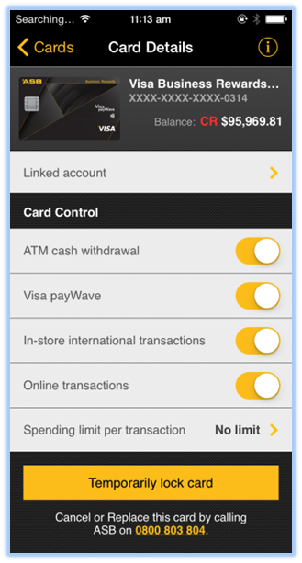
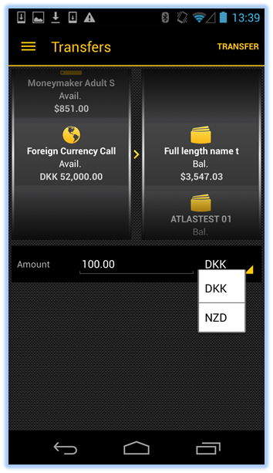
Latest Release
Card Controls
FCA Transfer
Notes:
Release 3.5
- Card controls - Turning different card features on and off - Card PINNING in 3.6
- FCA (Foreign Currency Accounts) - Transfer money between different accounts

Slide 5
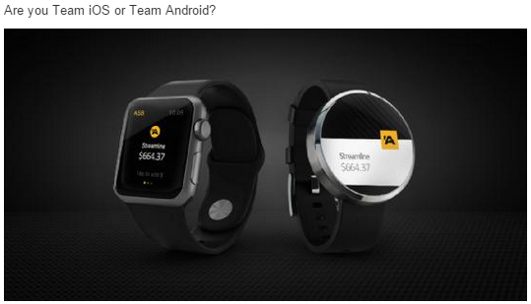
Future: Wearable Devices

